Slide 1
Be Believing
THAT YOU MAY
BELIEVE
THE GOSPEL ACCORDING TO JOHN
Dr. Rick Griffith • Crossroads International Church Singapore
BibleStudyDownloads.org

Slide 2
What is eternal life?
John
Notes:
People have long searched for eternal life.

Slide 3
Fountain of Youth
Notes:
Belief in the Fountain of Youth has captured the minds of explorers over the ages.

Slide 4
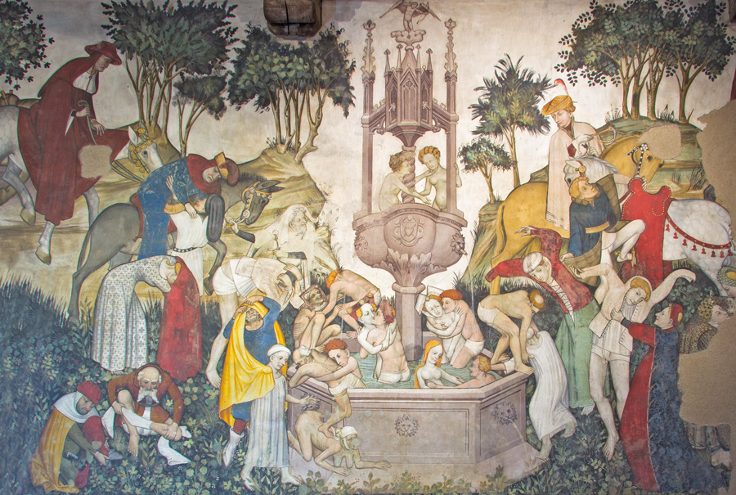
Fountain of Youth
Notes:
The Medieval Age imagined it in paintings…

Slide 5
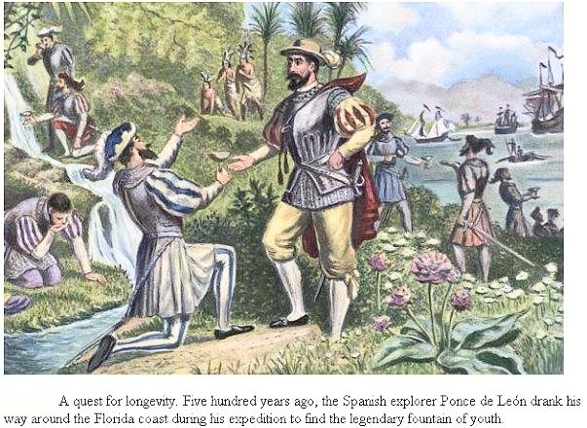
Fountain of Youth
Notes:
…and the Spanish explorer Ponce de Leon drank his way around the Florida coast to find the legendary fountain of youth.

Slide 6
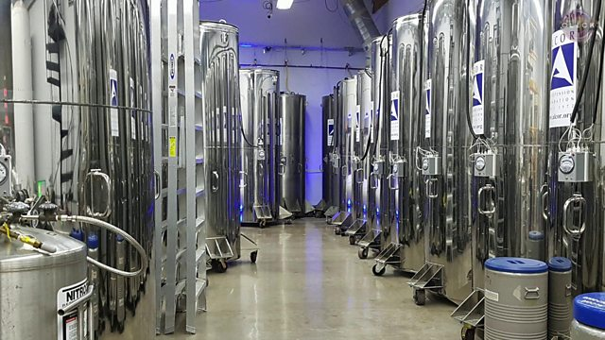
Cryonics (Body Freezing)
Notes:
More recently, freezing one’s body is one of the latest evidences of the desire for eternal life.

Slide 7
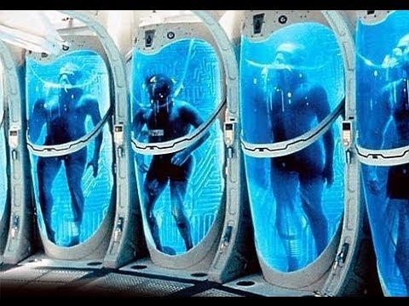
Cryonics (Body Freezing)
Notes:
Some pay good money before they die to keep their body frozen with the hope that someday they can be awakened when death is conquered.

Slide 8
“…He has planted eternity in the human heart…” (Eccl 3:11 NLT)
Notes:
In short, people want to live forever. Even Ecclesiastes says that God has put eternity in the heart of every person.

Slide 9
Do you have Eternal Life?
Notes:
Yes or no?

Slide 10
Need
Notes:
How do you think you got this life?
Do you feel you need to be good enough to go to God?
Do you think certain sins keep you out of heaven (LGBT)?

Slide 11
How can you obtain eternal life?
John
Notes:
What can a person do to live forever?

Slide 12
NT Overview (History)
38 124 39-41
"To the remotest part of the earth" (Acts 1:8)
Acts 9 13 14 15 16 18 21 27 28
Apr 48- Sep 49
1 Galatia
Apr 50- Sep 52
2 Aegean
Spr 53- May 57
3 Asia
Feb 60- Mar 62
1 Rome
Spr 62- Fall 67
4 Spain
Aut 67- Spr 68
2 Rome
Summer 35- 37
Damascus Antioch
May 57- Aug 59
Trials
Fall 49
The
Council
Spring 68
Expansion of Church
35 48 49 50 52 53 57 60 62 67 68 95
Matt
Luke
Acts
Mark
John
Gospels & Acts
1234
Journeys
Rome
Imprisonments
Gospels & Acts
Notes:
We have been making our way through the entire Bible with one sermon per book. Today we come to the 61st book—the Gospel of John. John’s gospel has been often called the Supplemental Gospel since it was written last.

Slide 13
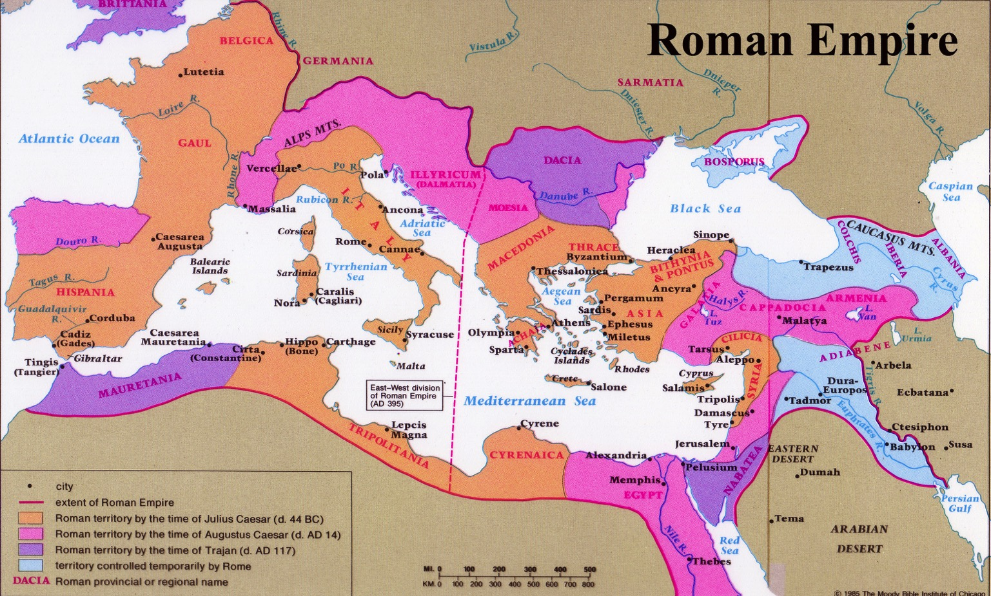
Origin
110
John wrote from Ephesus
Roman Empire
Recipients
The first readers are likely to have been Gentiles in John's own location at Ephesus.
Notes:
The other gospels had different goals and were mostly written for Christians. Yet John wrote from Ephesus to unbelieving Gentiles initially in his own location at Ephesus.

Slide 14
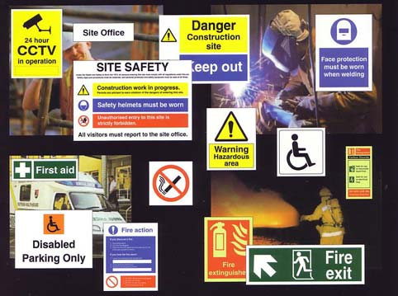
Signs are Vital to Life
Notes:
Signs are important in our lives.

Slide 15
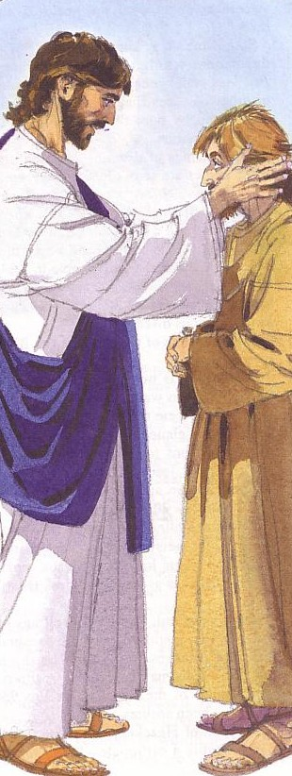
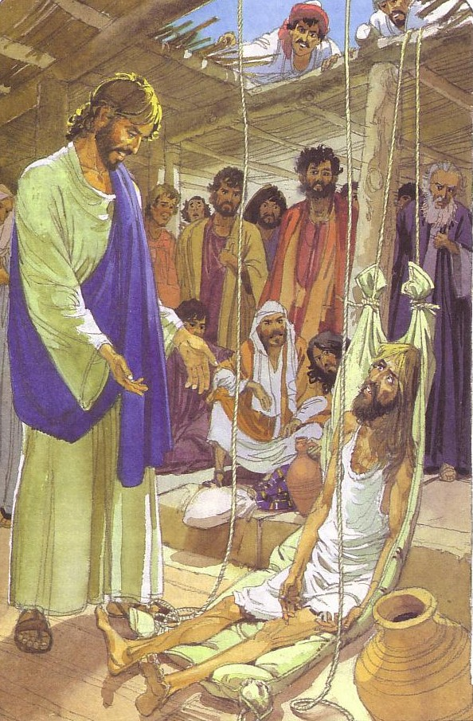
God's Love
Shown in Signs
Notes:
Likewise, John gives nine signs of God’s love.

Slide 16
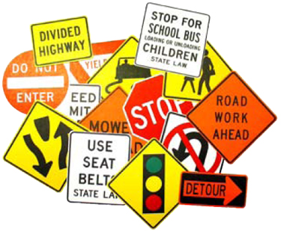
Signs in John's Gospel
111
Signs unique to John's Gospel in yellow (6 of the 9 miracles)
WATER TO WINE 2:1-11
HEALING OFFICIAL'S
SON 4:46-54
HEALING PARALYTIC 5:1-18
FEEDING 5000 6:1-15
WALKING ON WATER 6:16-24
HEALING BLIND MAN 9:1-7
RAISING LAZARUS 11:1-45
CHRIST'S RESURRECTION 20:1-31
FISH CATCH 21:1-3
Notes:
Six of the nine are unique to John and not found in Matthew, Mark, or Luke. Why?

Slide 17
Key Verse
107
"Jesus did many other miraculous signs in the presence of his disciples, which are not recorded in this book. But these are written that you may believe that Jesus is the Christ, the Son of God, and that by believing you may have life in his name" (20:30-31).
John
Notes:
John 20:30-31 explicitly notes that John’s gospel was composed to give non-Christians all that they needed to obtain eternal life. This is the only evangelistic gospel and is self-contained so that it has all that you would need to know to become a Christian.

Slide 18
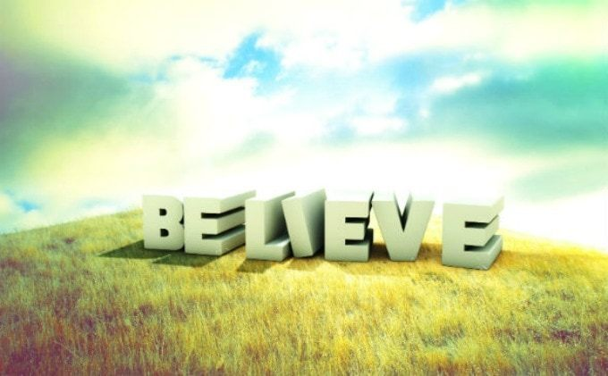
Key Word for John
Notes:
The key word is “believe,” which is used 87 times! John wrote after the others when the church was plagued with many opinions on how to obtain eternal life.

Slide 19
Theme
23
Deity Made Man for Eternal Life
John
Notes:
In this context, John was the last living disciple of Jesus and he said that eternal life was in Jesus.

Slide 20
Overview of John's Gospel
107
Deity Made Man for Eternal Life
Deity of the Son of God | Revelation of the Son of God |  | Preparation of the Son's Disciples | Passion & Resurrection of the Son of God | Adequacy of the Son of God
1:1-18 | 1:19–12:50 |  | 13–17 | 18–20 | 21
Prologue | Public |  | Private | Public | Private
Incarnation | 2 Signs Received 1:19–4:54 | 5 Signs Rejected 5–12 | Upper Room Discourse (no signs) | Ultimate Sign | Last Sign
Eternity Past | Fall AD 29- Monday, 30 March 33 |  | Thursday, 2 April 33 | Friday, 3 April 33- Sunday, 5 April 33 | May, AD 33
Ephesus (AD 65-69)
Notes:
Scholars debate whether John wrote in the 60s of the 90s. I think it was the early date, but the message is the same in either case. Both periods were times of persecution, apostasy, and heresy.

Slide 21
12 "I AM" STATEMENTS IN JOHN
111 113
1
MATTHEW
2
MARK
"I am [the Messiah]" (4:26)
"I am! Don't be afraid" (6:20)
"I am the bread of life" (6:35)
"I am the light of the world" (8:12)
"Before Abraham was, I am" (8:58)
"I am the door [of the sheep]" (10:7)
"I am the good shepherd" (10:11, 14)
"I am the resurrection and the life" (11:25)
“I am [he]” (13:19)
"I am the way, the truth, and the life" (14:6)
"I am the true vine" (15:1)
"He said to them, 'I Am [he]'" (18:5, 6, 8)
TO:
JEWS
TO:
ROMANS
AS:
KING
AS:
SERVANT
WHAT
HE:
SAID
WHAT
HE:
DID
3
LUKE
TO:
GREEKS
AS:
GOD/MAN
WHAT
HE:
FELT
Notes:
One unique element in John is the repetition of Jesus saying, “I Am.” These 12 occurrences all point back to God telling Moses in Exodus 3:14 that he was the “I Am” who was sending him. In other words, each of these indicates that Jesus is God!

Slide 22
How can you obtain eternal life?
John
Notes:
What can a person do to live forever?

Slide 23
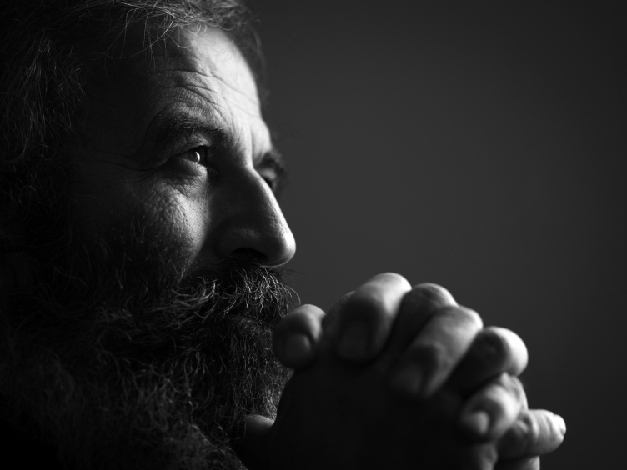
I. Eternal life in Jesus received a mixed response.
John 1–17
Notes:
Some believed in Christ but most rejected him.

Slide 24
John said eternal life comes by trusting Jesus as God made man (1:1-18).
Notes:
John was quite clear what he thought!

Slide 25
Slides on John 1

Slide 26
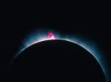
Jesus has always been God
"In the beginning
was the Word,
and the Word was with God,
and the Word was God"
(John 1:1)

Slide 27
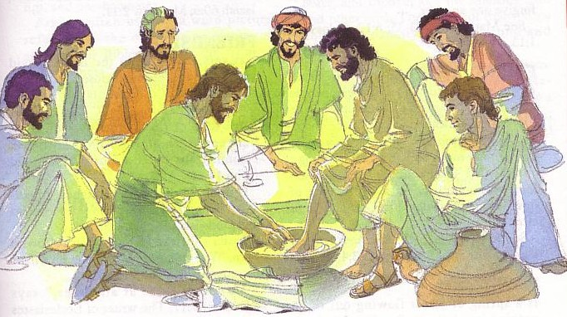
God became man in Jesus
"So the Word became human and lived here on earth among us. He was full of unfailing love and faithfulness. And we have seen his glory, the glory of the only Son of the Father" (John 1:14 NLT)

Slide 28
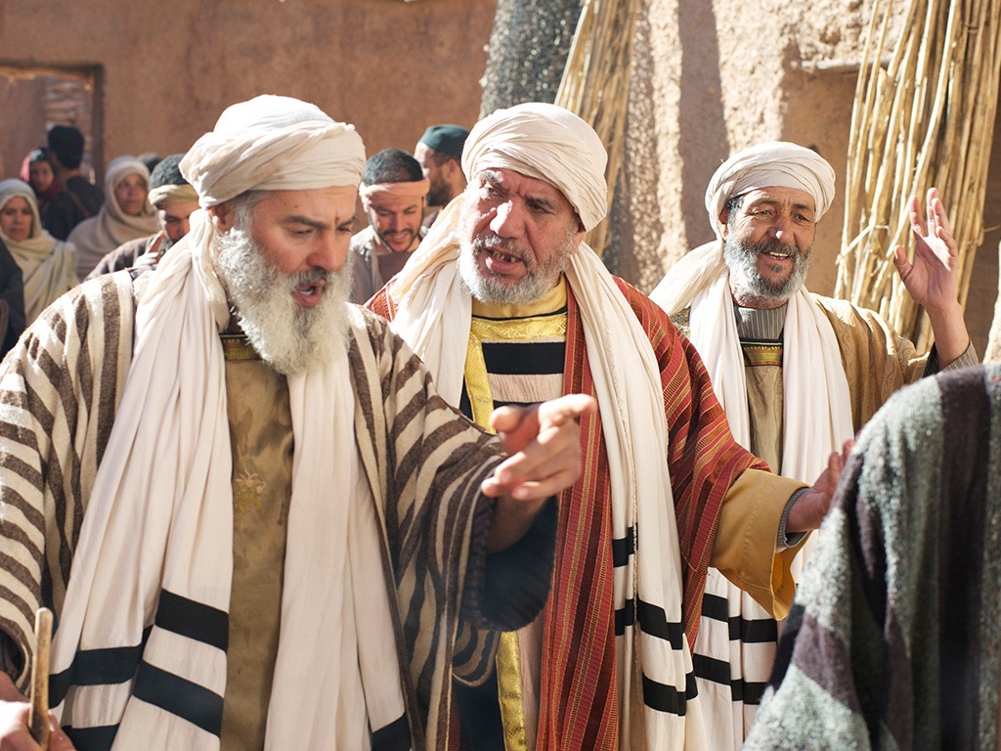
Jews rejected Christ even though he was Jewish (1:11)
"He came to that which was his own, but his own did not receive [Gr. 'welcome alongside'] him" (NIV).

Slide 29
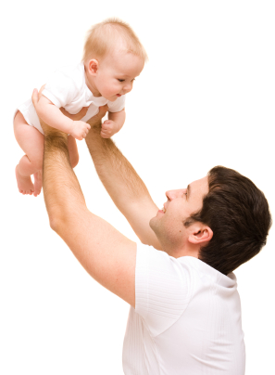
You become a child of God by believing that Jesus is God:
"But to all who believed him and accepted him, he gave the right to become children of God" (John 1:12 NLT)

Slide 30
People both believed and rejected Christ's public revelation of himself as God (1:19–12:50).

Slide 31
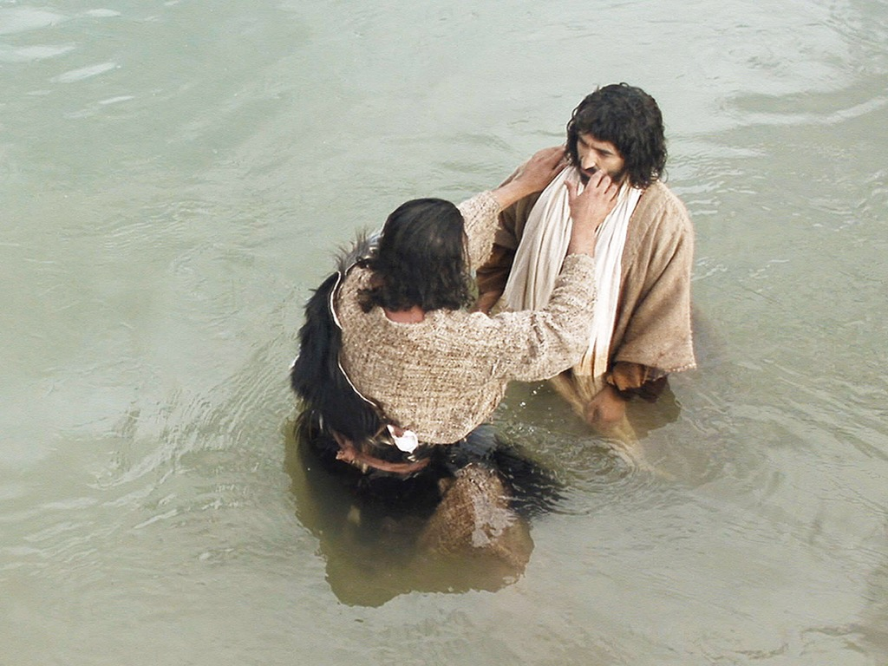

Slide 32
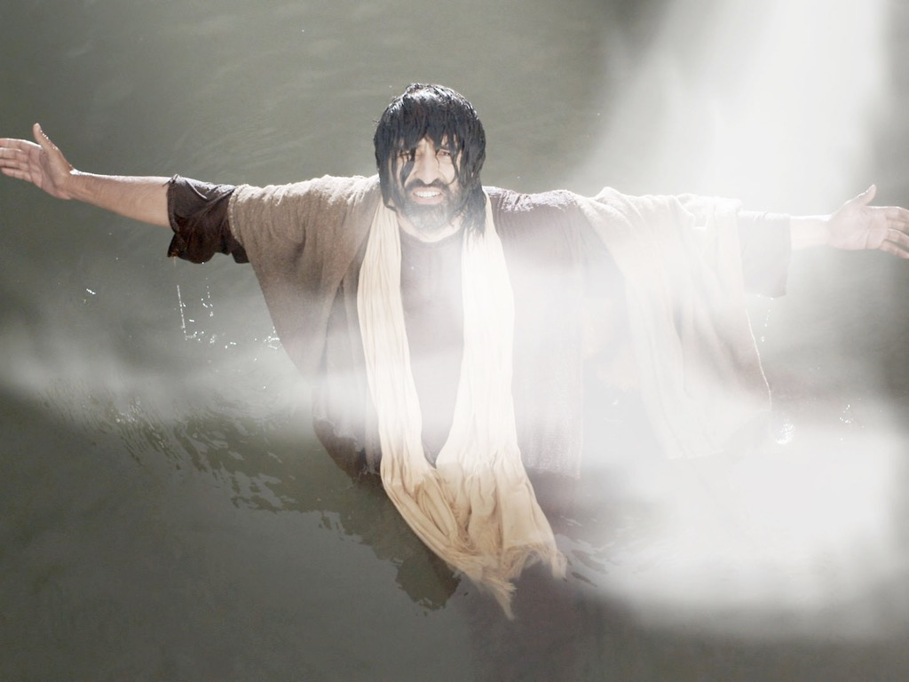

Slide 33
Slides on John 2

Slide 34
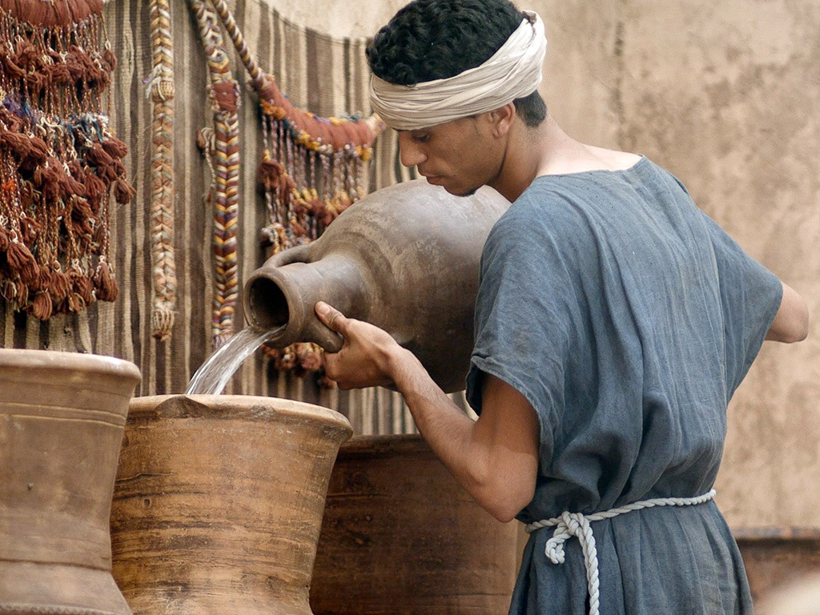
Free Bible images
John 2:1-11
WEDDING AT CANA

Slide 35
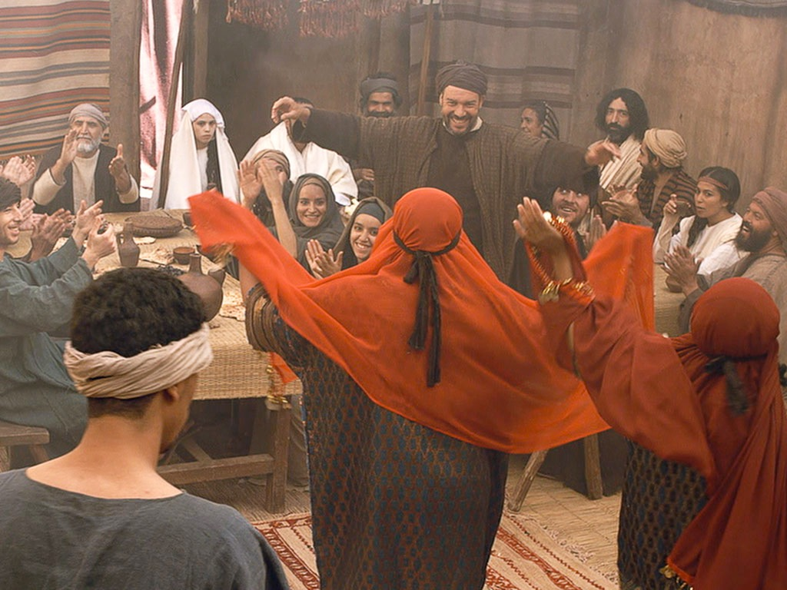

Slide 36
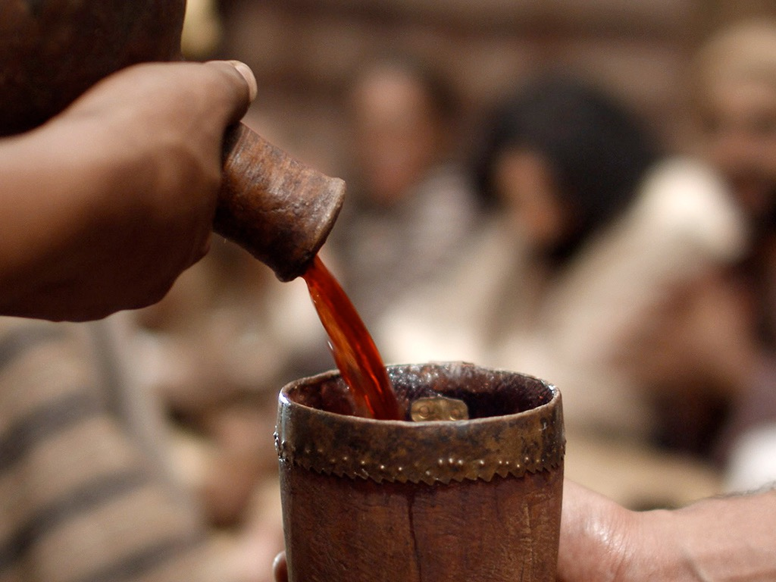

Slide 37
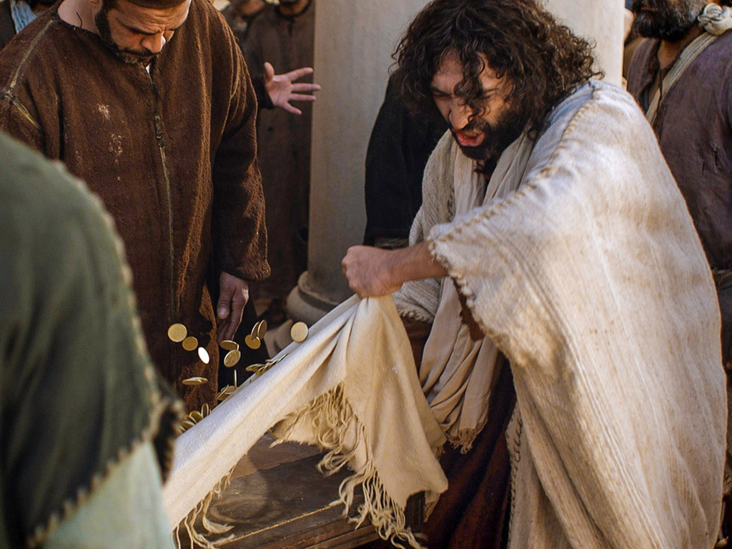
Matthew 21:12-17
Mark 11:15-19
Luke 19:45-48
John 2:13-24
THE EASTER STORY
CLEANSING THE TEMPLE
Free Bible images

Slide 38
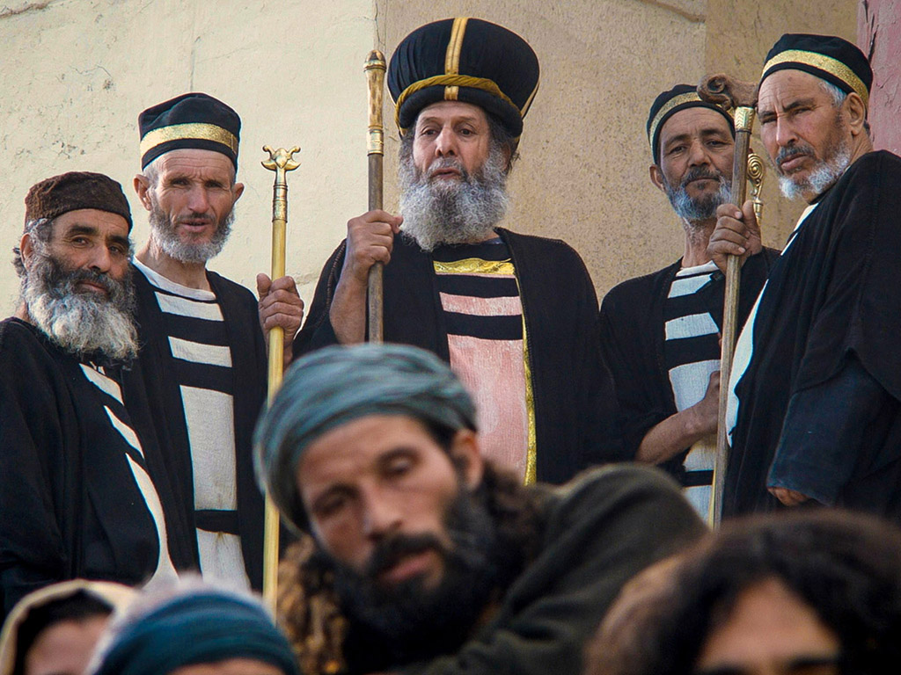
But the Jewish leaders demanded, “What are you doing? If God gave you authority to do this, show us a miraculous sign to prove it.”

Slide 39
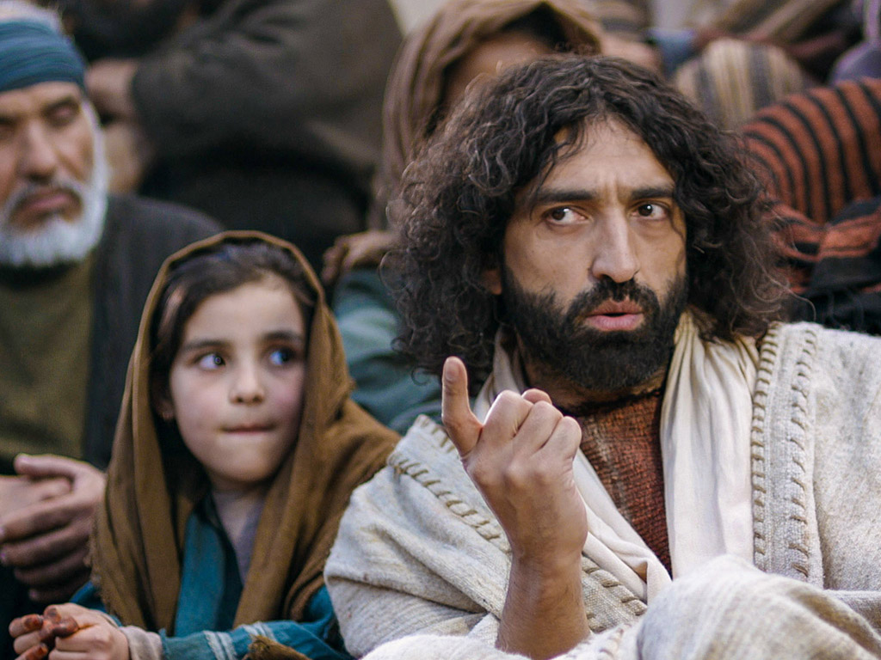
“All right,” Jesus replied. “Destroy this temple, and in three days I will raise it up.”

Slide 40
Slides on John 3

Slide 41
119d
"Jesus replied, 'I assure you, no one can enter the Kingdom of God without being born of water and the Spirit.'"
John 3:5

Slide 42
"For God loved the world so much that he gave his one and only Son, so that everyone who believes in him will not perish but have eternal life."
John 3:16 NLT

Slide 43
Slides on John 4

Slide 44
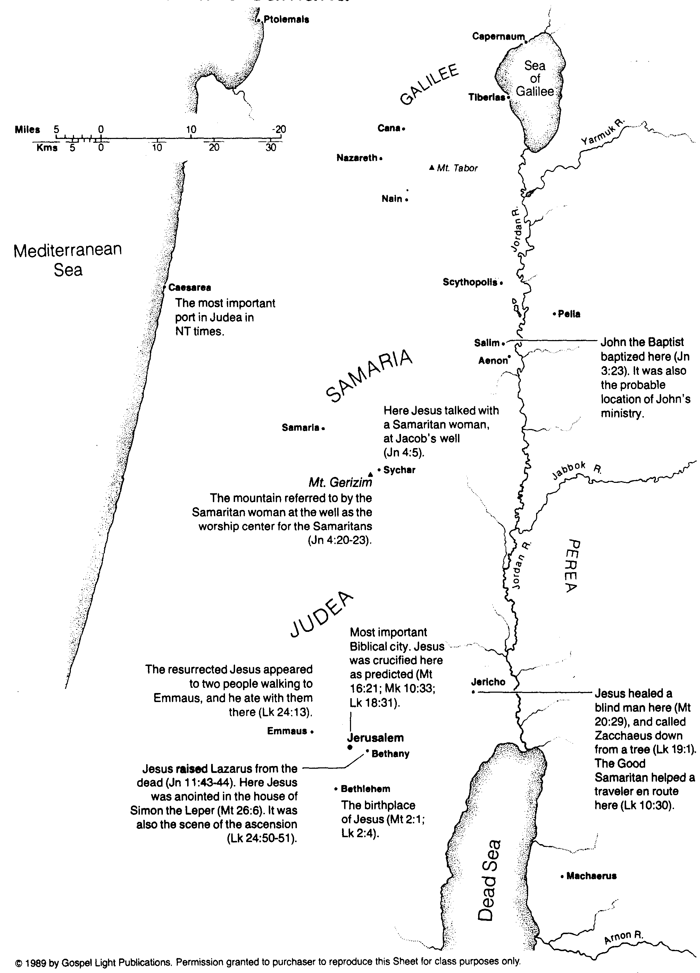
Jesus in Judea and Samaria
107

Slide 45
Slides on John 5
Notes:
Most rejected Jesus as the Son of God (5:1–12:50).

Slide 46
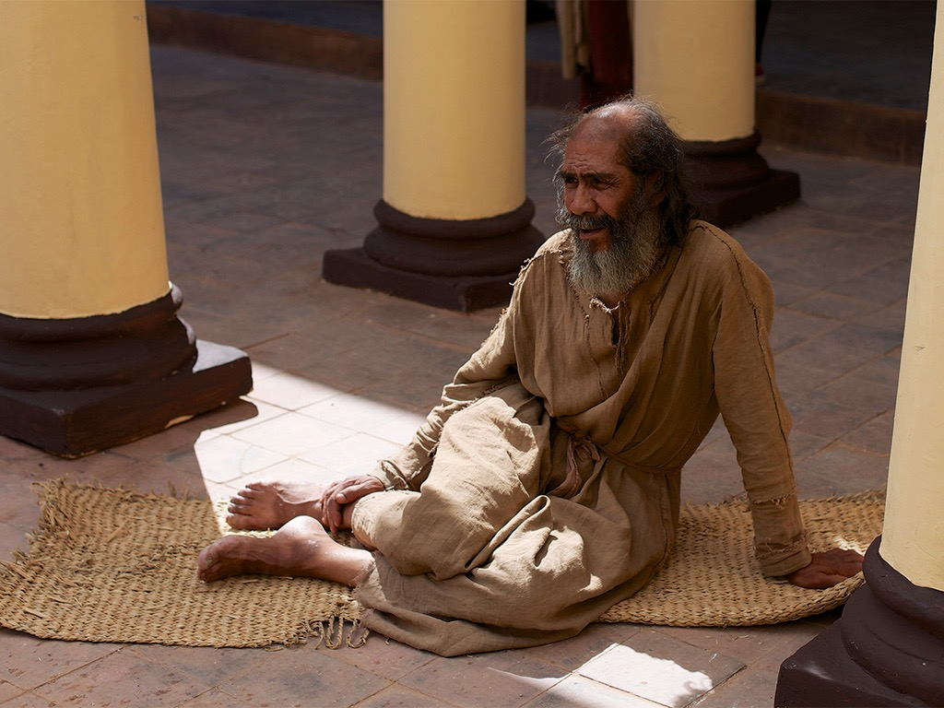
Free Bible images
John 5:1-30
JESUS AND THE LAME MAN AT THE POOL OF BETHESDA

Slide 47
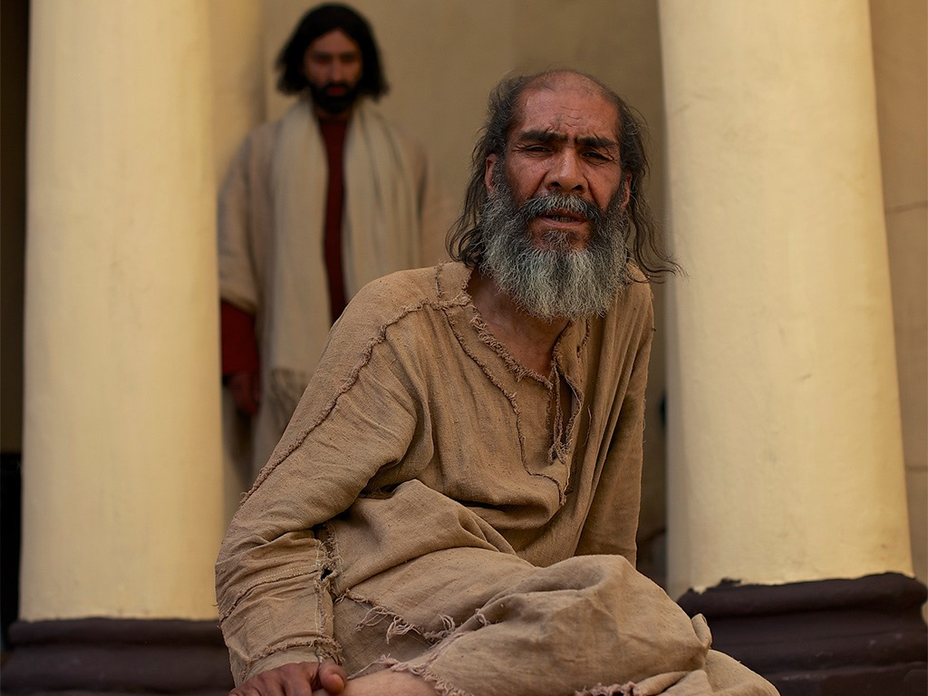

Slide 48
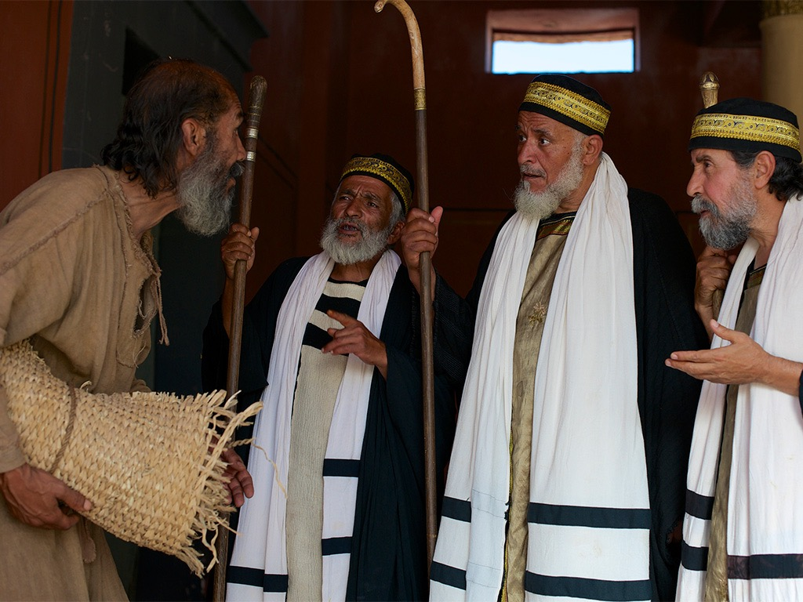

Slide 49
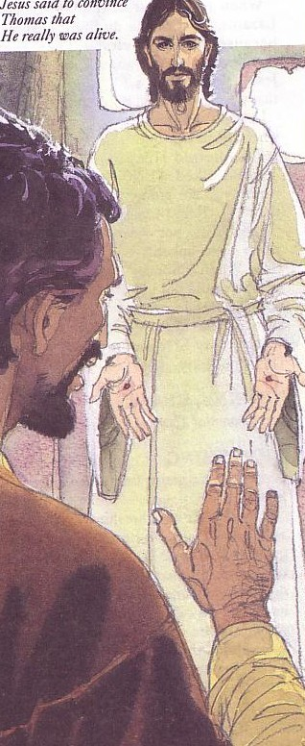
What is "Belief" in Christ?
119
Faith
+
Repentance
=
Conversion
Faith is being satisfied with Christ
MIND
Knowledge
Recognition
Assent
Conviction
Trust
Turning
EMOTIONS
WILL
Dr. Mahlon Friesen, First Baptist Church, Yucaipa, CA

Slide 50
“I tell you the truth, those who listen to my message and believe in God who sent me have eternal life. They will never be condemned for their sins, but they have already passed from death into life” (John 5:24 NLT)

Slide 51
Slides on John 6

Slide 52
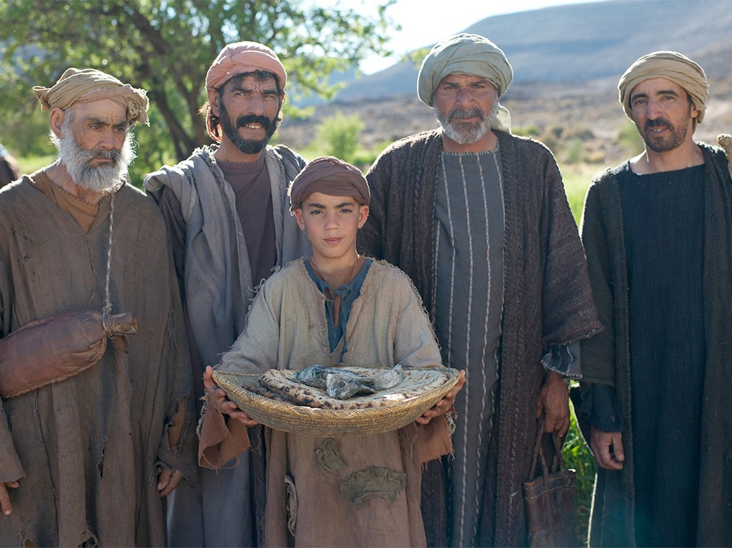
JESUS FEEDS 5000
Free Bible images
Matthew 14:13-22
Mark 6:31-46
Luke 9:10-17
John 6:1-13

Slide 53
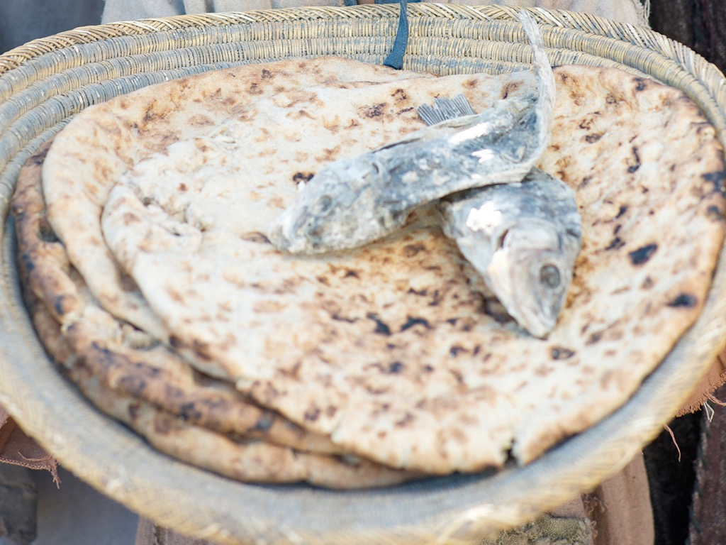

Slide 54
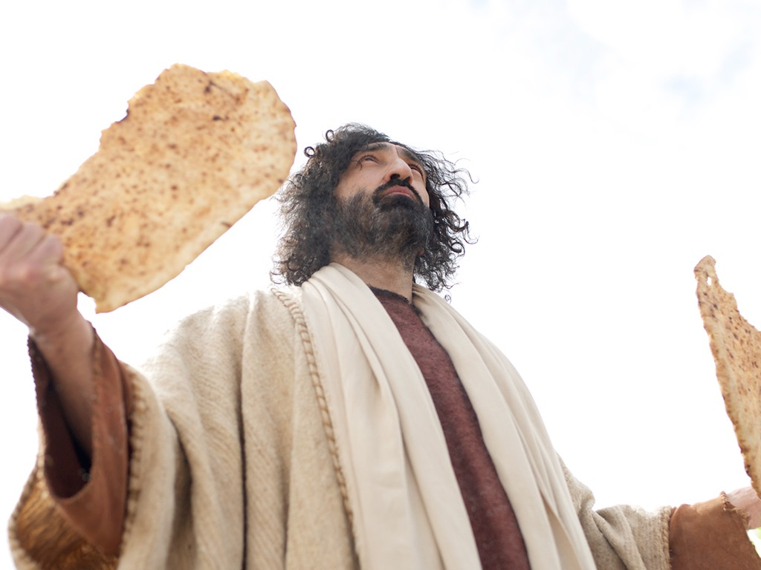

Slide 55
A Controversial Figure in John 1–6
Believers in John 1-4:
Galileans
Samaritan Woman
John the Baptist
Nicodemus
Passover Jews
Disciples
The line of faith
Unbelievers in John 5–6:
Jerusalem Leaders
Galilean People
Disciples desert Jesus

Slide 56
Slides on John 8

Slide 57
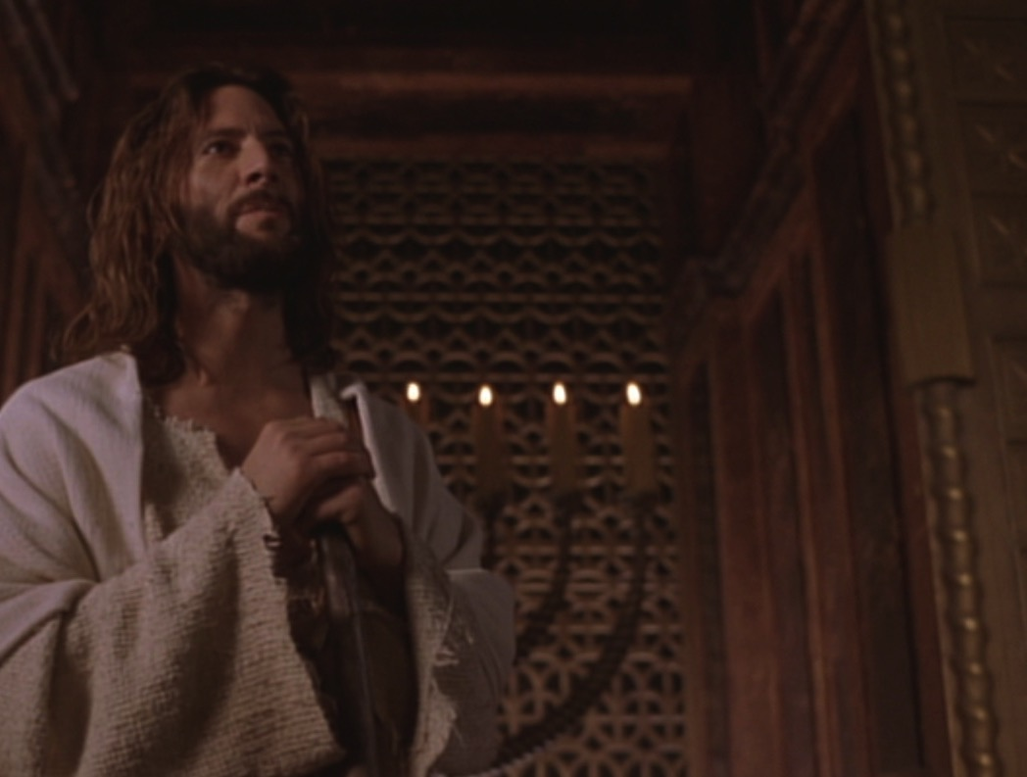
"I am the light of the world"
John 8:12

Slide 58
Slides on John 11

Slide 59
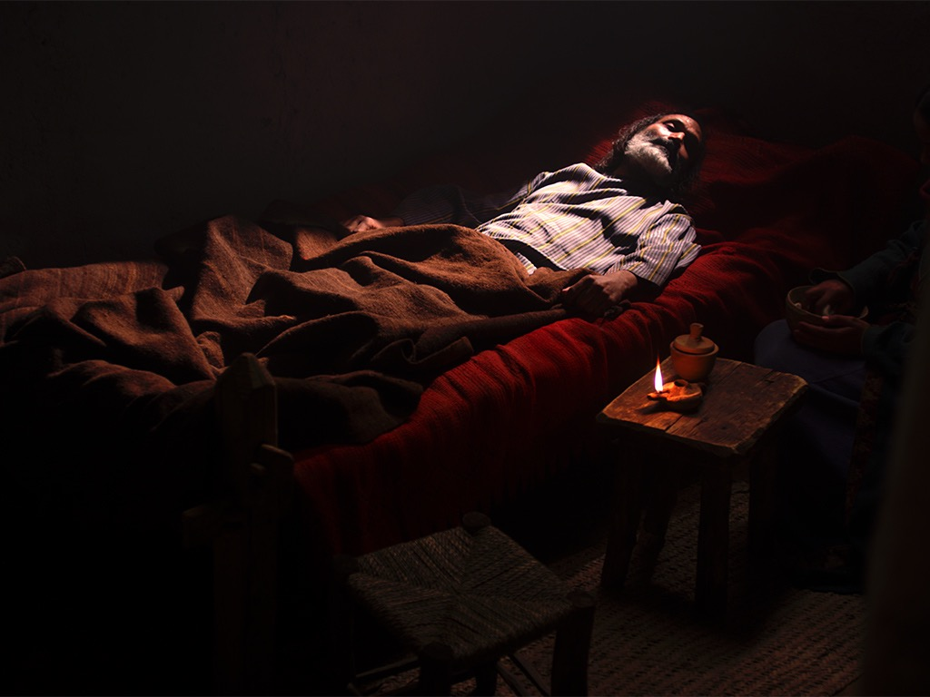
Free Bible images
John 11:1–12:2
JESUS RAISES LAZARUS

Slide 60
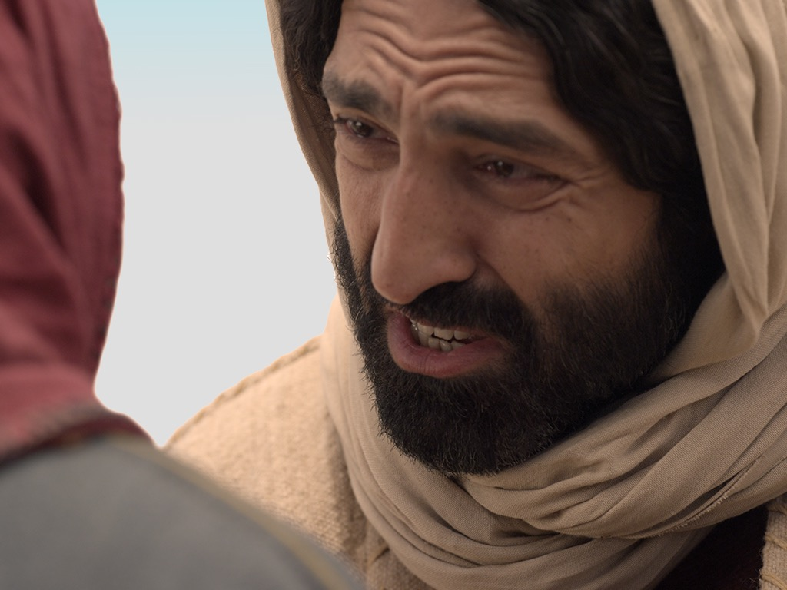

Slide 61
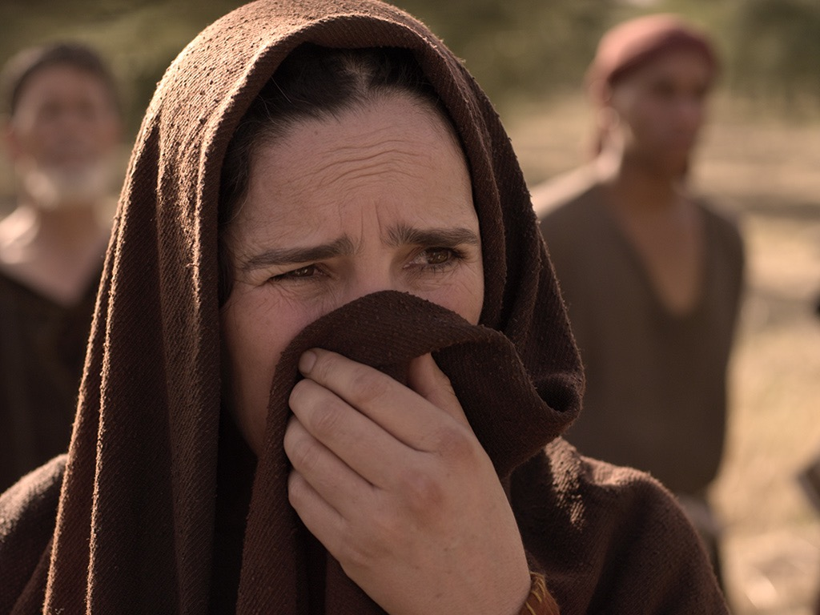

Slide 62
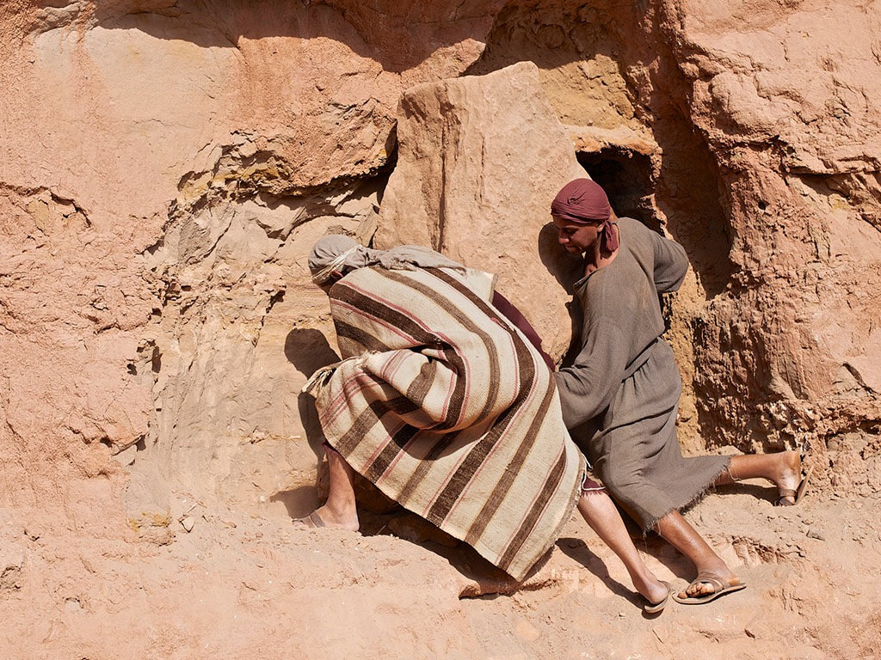

Slide 63
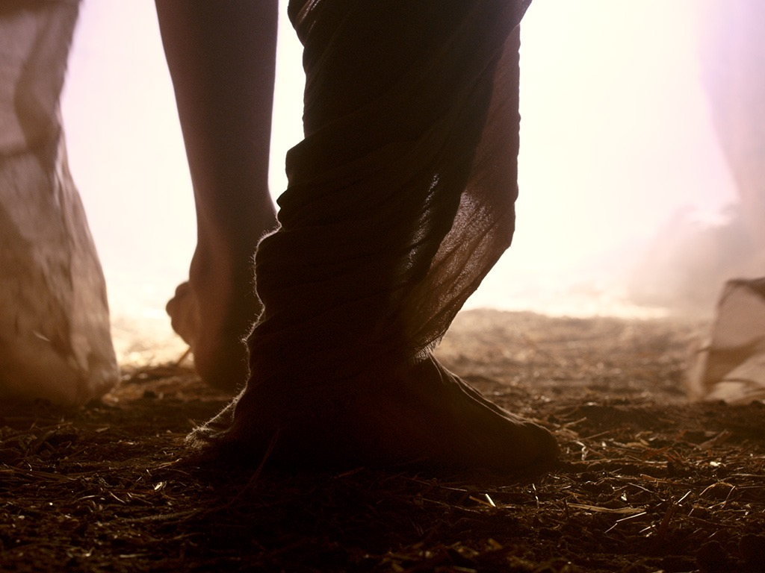

Slide 64
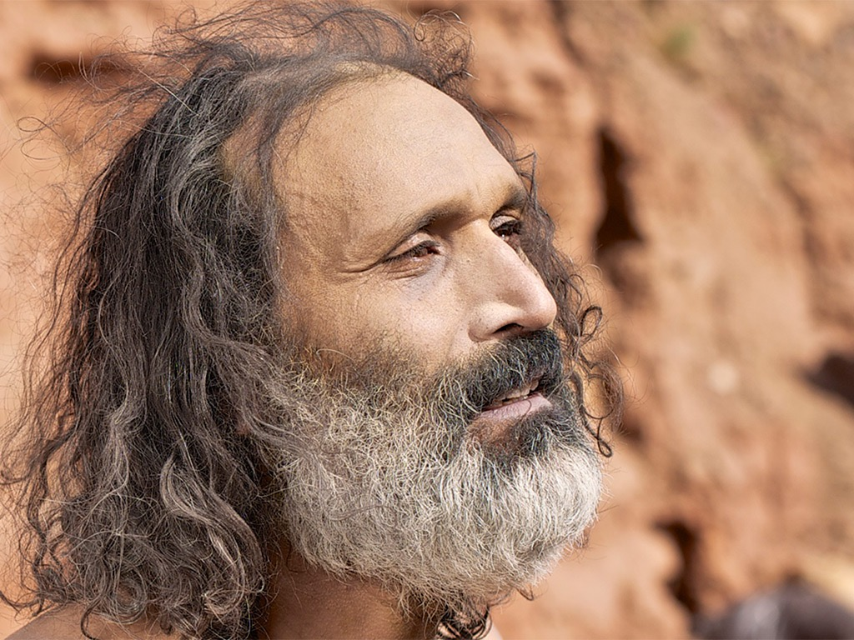

Slide 65
People both believed and rejected Christ's public revelation of himself as God (1:19–12:50).

Slide 66
Slides on John 12

Slide 67
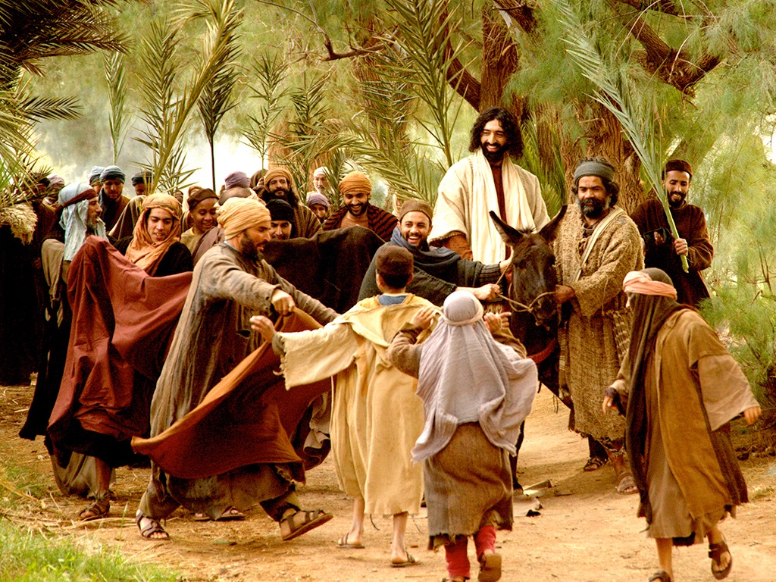
Matthew 21:1-11
Mark 11:1-11
Luke 19:28-44
John 12:12-19
THE EASTER STORY
TRIUMPHAL ENTRY (Palm Sunday)

Slide 68
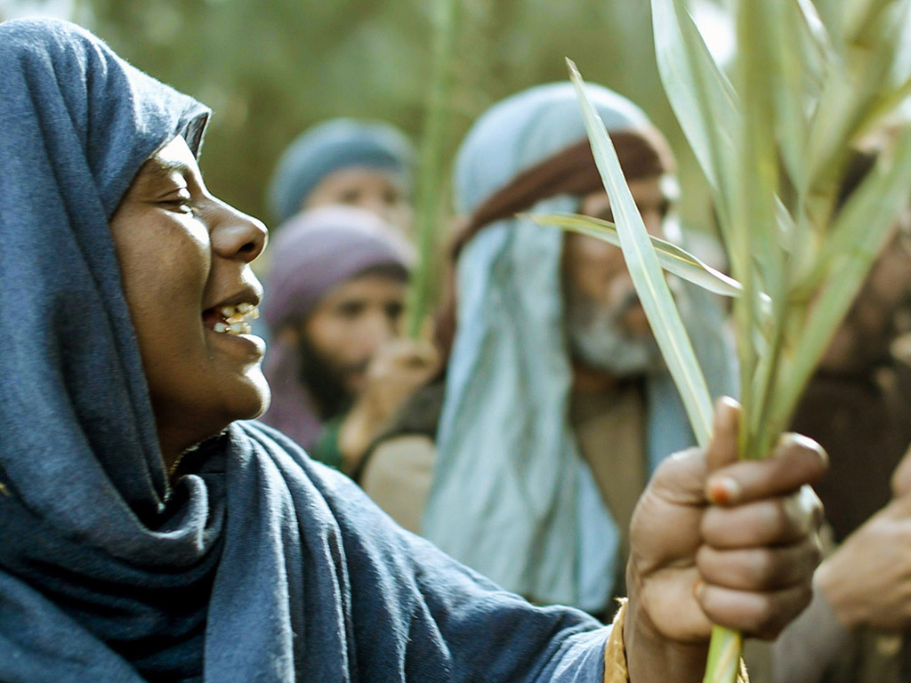

Slide 69
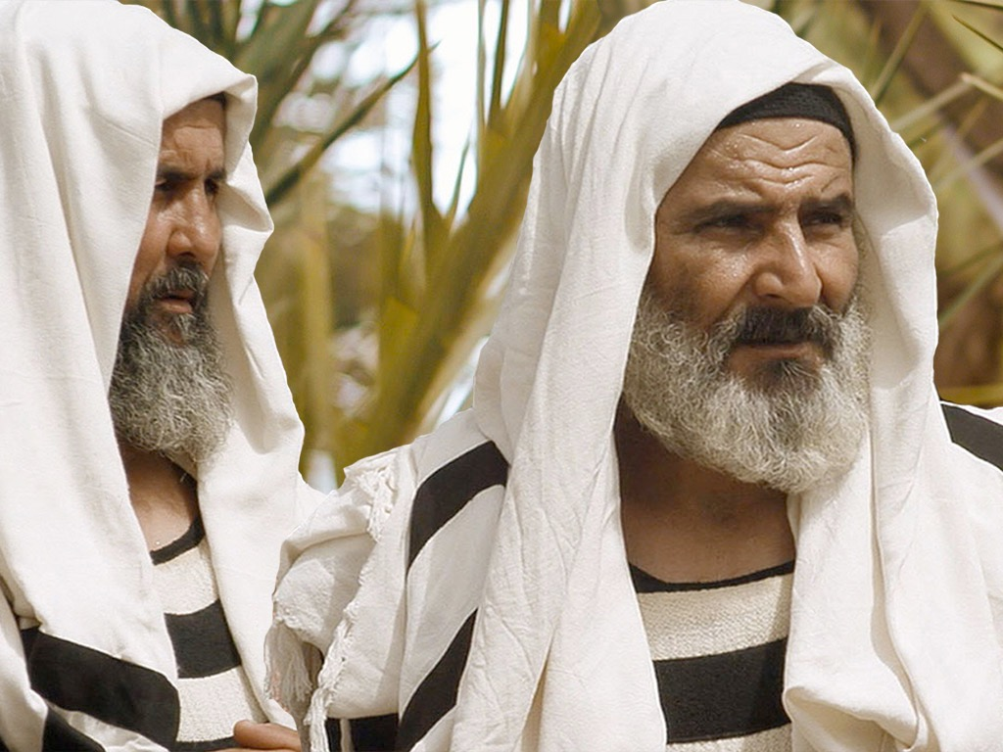

Slide 70
Slides on John 13

Slide 71
Jesus prepared his disciples to depend on the Holy Spirit (John 13–17).

Slide 72
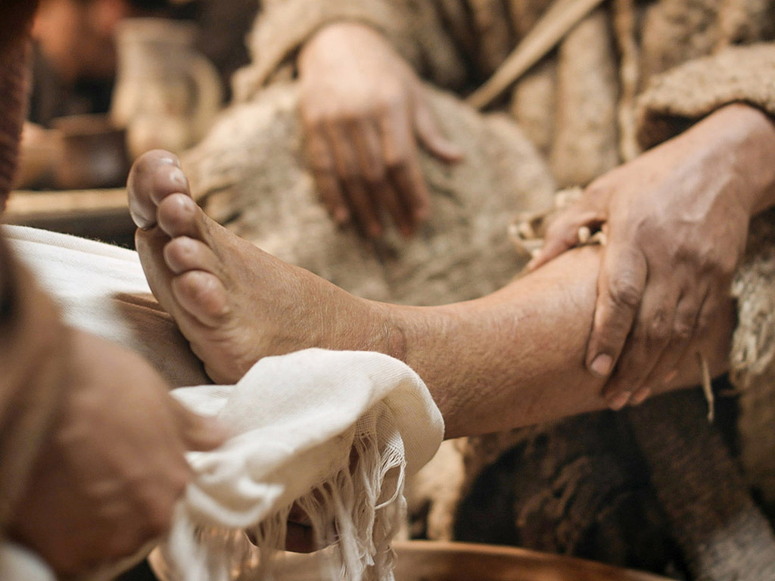
John 13:1-17
Free Bible images
THE EASTER STORY
JESUS WASHES THE DISCIPLES' FEET

Slide 73
Slides on John 14
Notes:
Jesus actually had prepared them for his absence in John 14. He told them that he would send the Spirit!

Slide 74
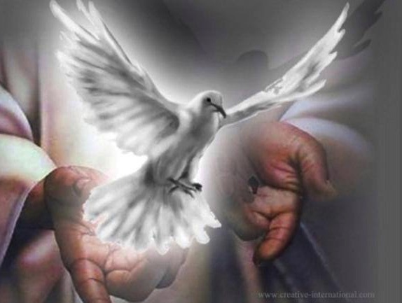
John 14:15-17
xvi II. D.
¹⁵"If you love me, you will obey what I command. ¹⁶And I will ask the Father, and he will give you another Counselor to be with you forever — ¹⁷the Spirit of truth. The world cannot accept him, because it neither sees him nor knows him. But you know him, for he lives with you and will be in you."
Notes:
74
This indwelling is PERMANENT (forever) and for ALL believers!

Slide 75
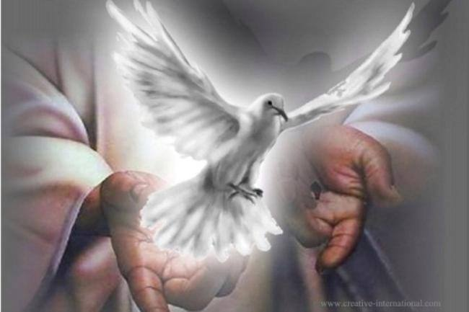
The Paraclete (John 14:16)
Advocate = Counselor = Comforter
Greek = “one who comes alongside”
Greek options for “another”:
Heteros = “another of a different kind”
Allos = “another of the same kind”
The Spirit will come alongside us in the same way as Jesus Himself!

Slide 76
Slides on John 15

Slide 77
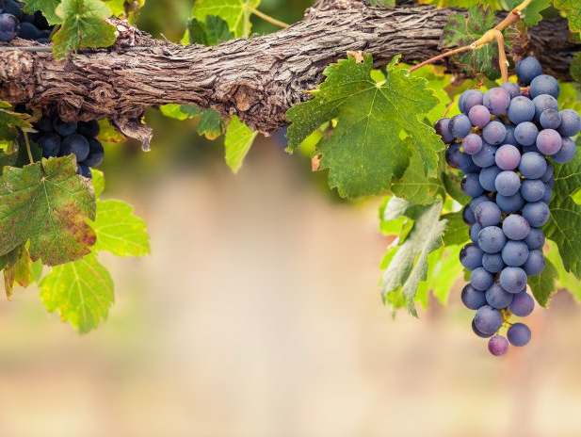
I am the Vine
You are the branches
15
Those who remain in me, and I in them, will produce much fruit. For apart from me you can do nothing.
John 15:5 NLT

Slide 78
Slides on John 16

Slide 79
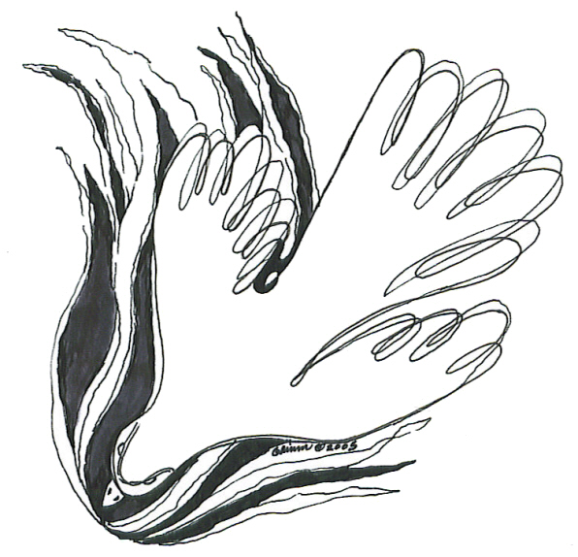
Key Ministries of the Spirit (16:5-15)
To Unbelievers 8-11
To Believers 12-15
Conviction
Teaching

Slide 80
Slides on John 17

Slide 81
A Pattern for Prayer
II. Pray for those you influence to be protected and holy.
Unity
I. Pray that you will glorify God by fulfilling his calling for you.
III. Pray for all believers to be a united witness
to the world.

Slide 82
Slides on John 18

Slide 83
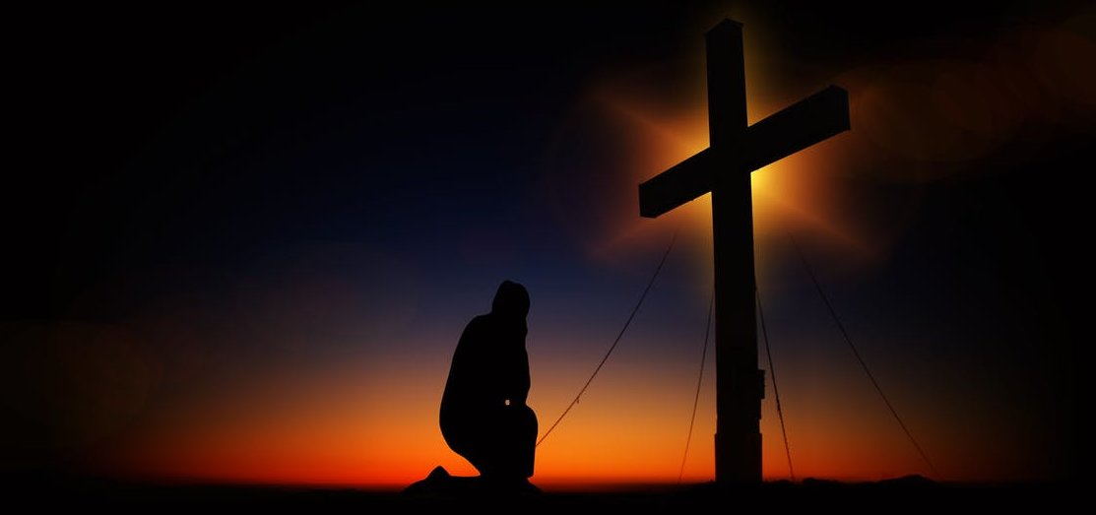
II. Eternal life comes by believing that Jesus died and rose for you.
John 18–21
Notes:
You can live forever when trust that Jesus paid for your sins and lives now.

Slide 84
God’s plan was for Jesus to die and rise back to life for you (John 18–20).

Slide 85
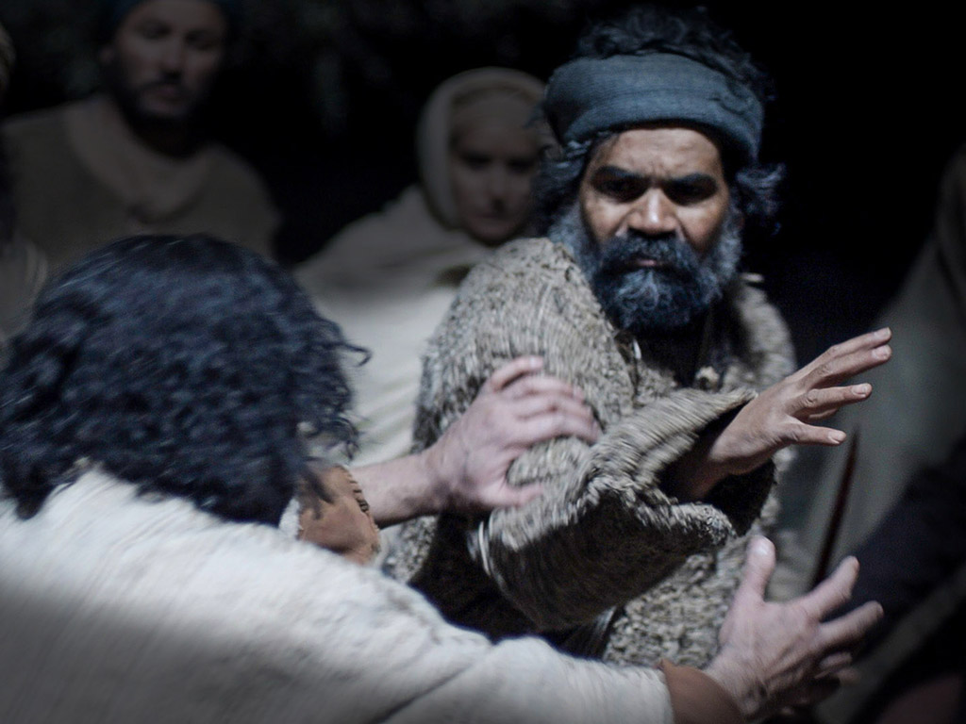

Slide 86
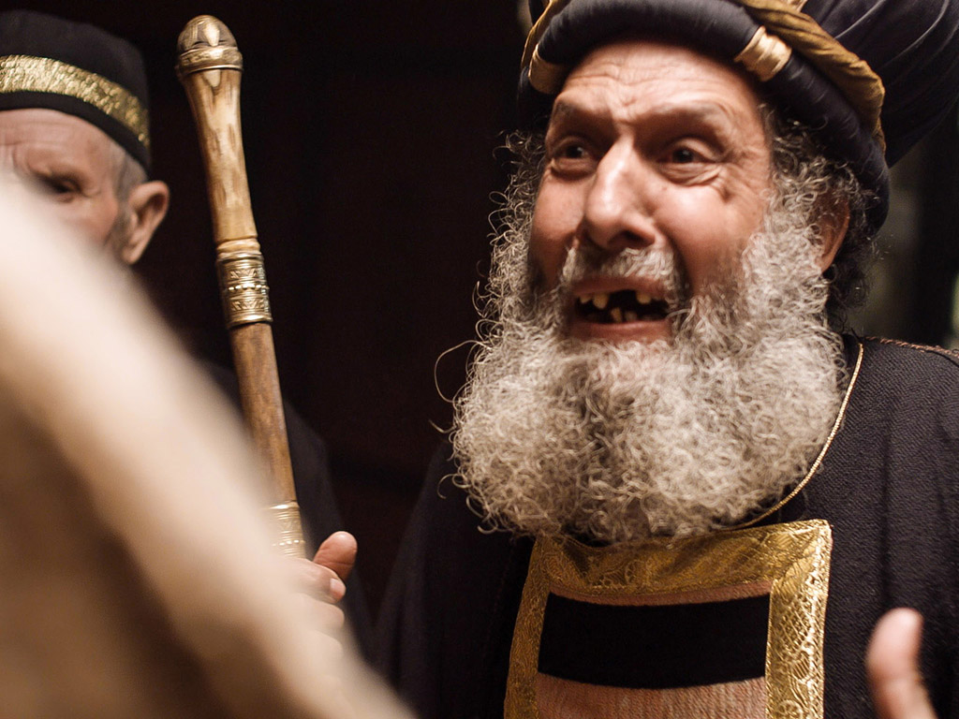

Slide 87
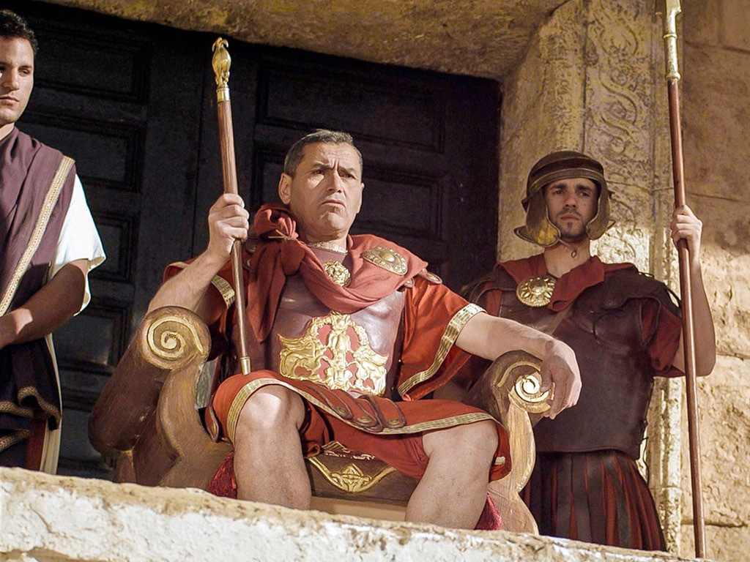

Slide 90
Slides on John 20

Slide 91
Matthew 28:1-15
Mark 16:1-20
Luke 24:1-47
يوحنا 20:1-29
صور كتابية مجانية
THE EASTER STORY
JESUS IS ALIVE

Slide 96
Slides on John 21

Slide 97
Jesus taught his adequacy for all who believe (John 21).

Slide 98
Free Bible images
John 21:1-14
THE EASTER STORY
JESUS APPEARS TO DISCIPLES IN GALILEE

Slide 101
How can you obtain eternal life?
John
Notes:
What can a person do to live forever?

Slide 102
I. Eternal life in Jesus received a mixed response.
John 1–17
Notes:
Some believed in Christ but most rejected him.

Slide 103
II. Eternal life comes by believing that Jesus died and rose for you.
John 18–21
Notes:
You can live forever when trust that Jesus paid for your sins and lives now.

Slide 104
Main Idea
Eternal life comes by trusting Jesus as God made man.
John

Slide 105
The Divine Code
For God so loved the world that he gave his one and only Son, that whoever believes in him shall not perish but have eternal life.
John 3:16
Notes:
This may look like a cryptic message but it's actually the best known verse in the Bible. It tells us that God gives us life with him forever when we simply place our trust in Jesus Christ. This is no da Vinci Code. It's the Divine Code!

Slide 106
Jesus rose to give you new life!
Jesus rose to give you new life!
Notes:
In his nearly 600 page paperback that supposedly tells us the "truth" of Christianity, Brown NEVER EVEN ONCE mentions the resurrection of Christ. This is the CHIEF teaching of Christianity--that Christ proved his claims by coming back from the dead.

Slide 107
How can you know Him?
Admit you have sinned
Believe that Jesus died for you
Confess that you have changed your mind about what or who can save you (repent)
Notes:
This means Jesus is alive today. This also means you can know him personally. It's as simple as A-B-C. Let's bow our heads and if you wish to come into this new relationship with Christ, please pray to him now, acknowledging these three things to him.

Slide 108
Black

Slide 109
NT Preaching • BibleStudyDownloads.org
Get this presentation and script for free!

